Slide 1
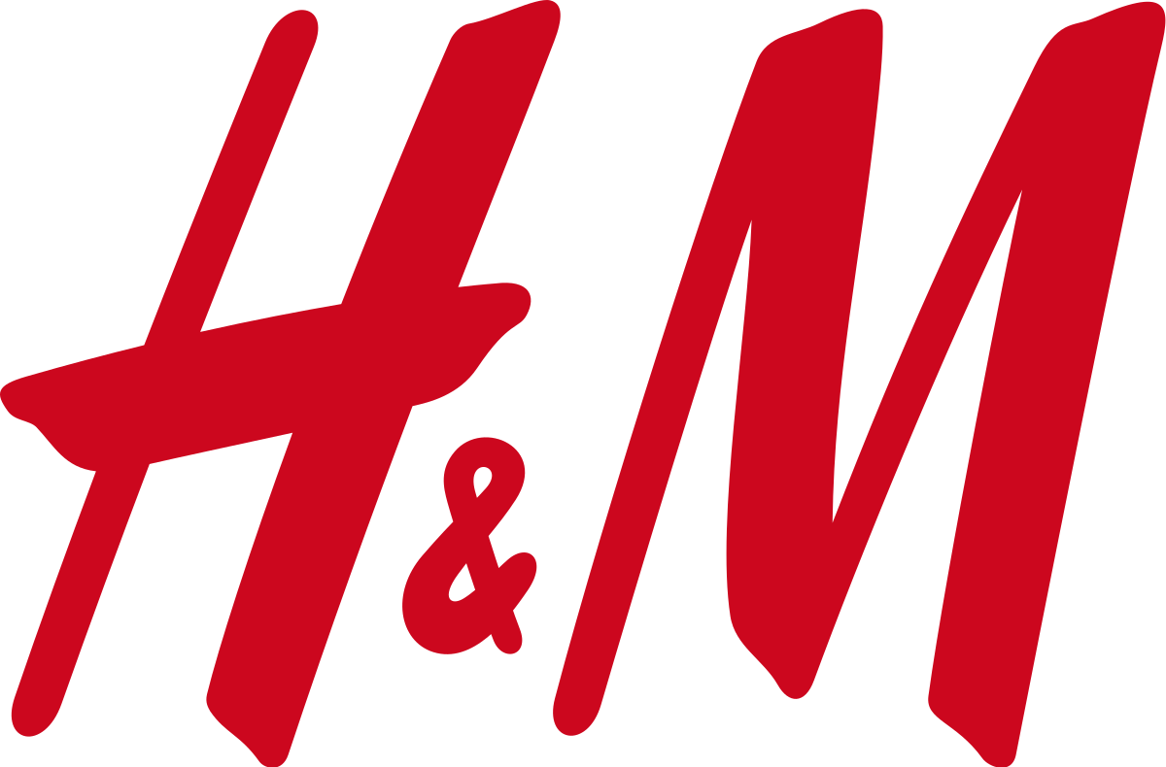
CASE STUDY
Revolutionizing Fashion with AI

Slide 2
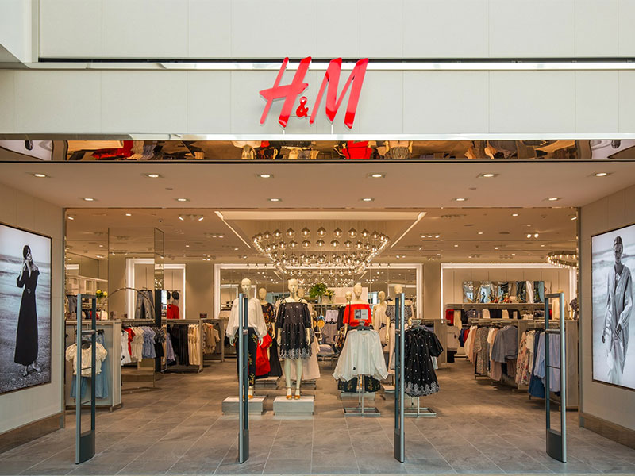
H&M is a Swedish multinational clothing-retail company known for its fast-fashion clothing.
It has 4913 stores spread across 74 countries throughout the globe.
NET WORTH as of May,2021 according to FORBES is $18.8 Billion.

Slide 3
PROBLEM
As a major disruptor and innovator in the fashion and retail industry, H&M relies on data as the core for everything they do. With stores opening up globally at a rapid pace, they needed to improve supply chain and forecasting operations to streamline costs and maximize revenues.

Slide 4
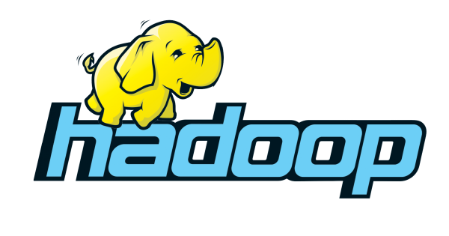
But their on-premise Hadoop system crippled their ability to ingest and analyze data generated by millions of customers needed to power predictive models.

Slide 5
WHY HADOOP WAS INSUFFICIENT ?
Massive volumes of data from over 5,000 stores in over 70 markets, with millions of customers every day.
Data engineering was challenged with fixed size clusters, complex infrastructure that was resource intensive and costly to scale, and data security issues.

Slide 6
Struggled to scale operations to support data science efforts against all of this data coming from various data sources.
Time-to-time market suffered because of significant delays, which impacted the ability for their data scientists to build, train, and deploy models quickly. It would take a whole year to go from making decisions to

Slide 7

SOLUTION AND IMPLEMENTATION
Understanding they had reached their scalability ceiling, H&M moved to Databricks Unified Data Analytics Platform to simplify infrastructure management, enable performant data pipelines at scale, and simplify the machine learning lifecycle — allowing them to make data-driven decisions that accelerate business growth.

Slide 8

Databricks provides H&M with a Unified Data Analytics Platform on Azure.
Fully managed platform with automated cluster management simplified infrastructure management and operations at scale
Collaborative notebook environment with support for multiple languages (SQL, Scala, Python, R) enables a diverse team of users to work together in their preferred language — creating a unified cross-team environment to fuel productivity.

Slide 9
RESULTS
With help of DataBricks , H&M is making data more accessible for each and every decision maker, making business grow faster and more relevant.
Features of Azure such as Auto-Scaling Clusters has improved operations from data ingest to managing the entire machine learning which helped in reducing operational costs by 70 %.

Slide 10
Unified analytics environment for both data scientists and engineers has dramatically reduced the number of components needed to go in production with easy setup and management.
The ability to be more granular in decision making has allowed them to improve strategic decisioning and business forecasting.

Slide 11
THANK YOU

